Slide 1




Unlock the hidden potential of Virtual tables
Nathalie Leenders

Slide 2

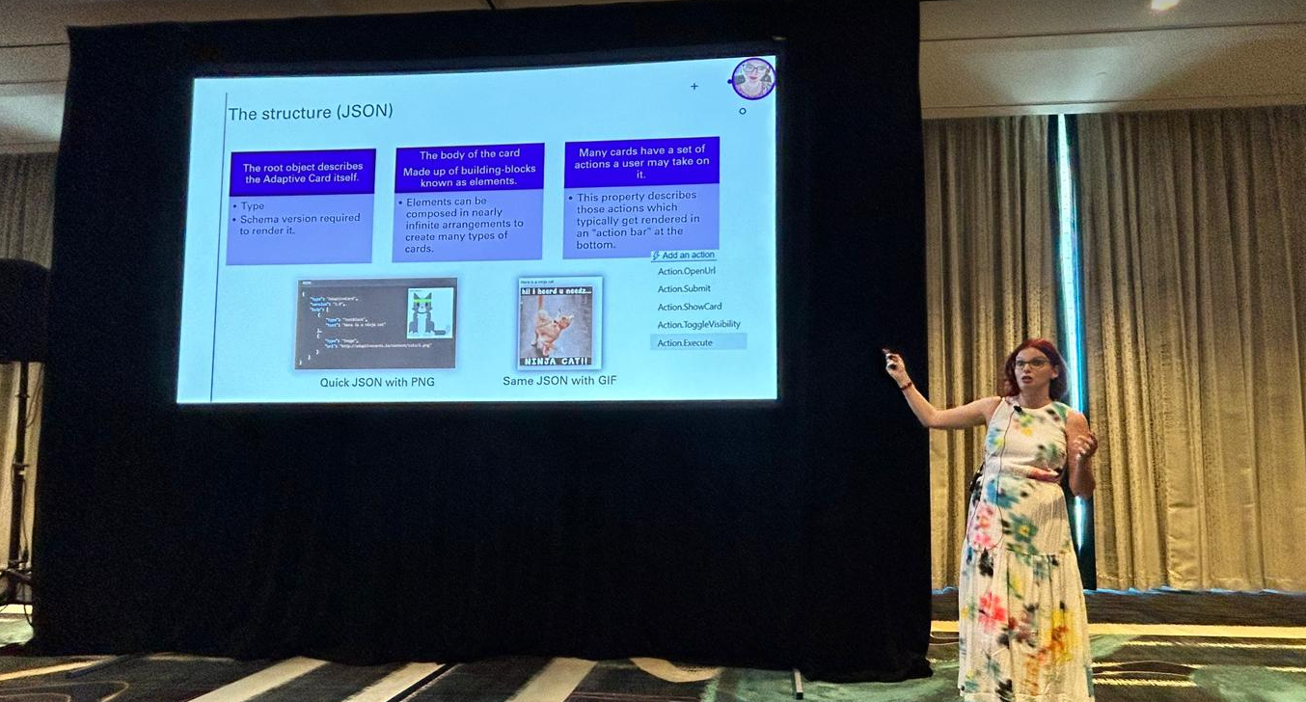


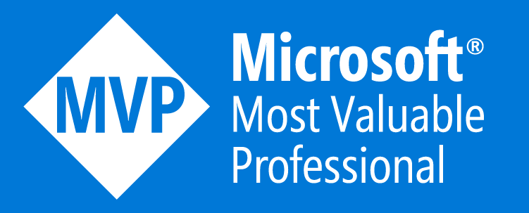
Who am I?
Nathalie Leenders
Power Platform Consultant at Wortell
Microsoft MVP Business Applications
MCT
Has a purrrsonal assistant called Floof
Loves to travel and share knowledge
Loves to post the 🦡
www.nathalieleenders.com

Slide 3




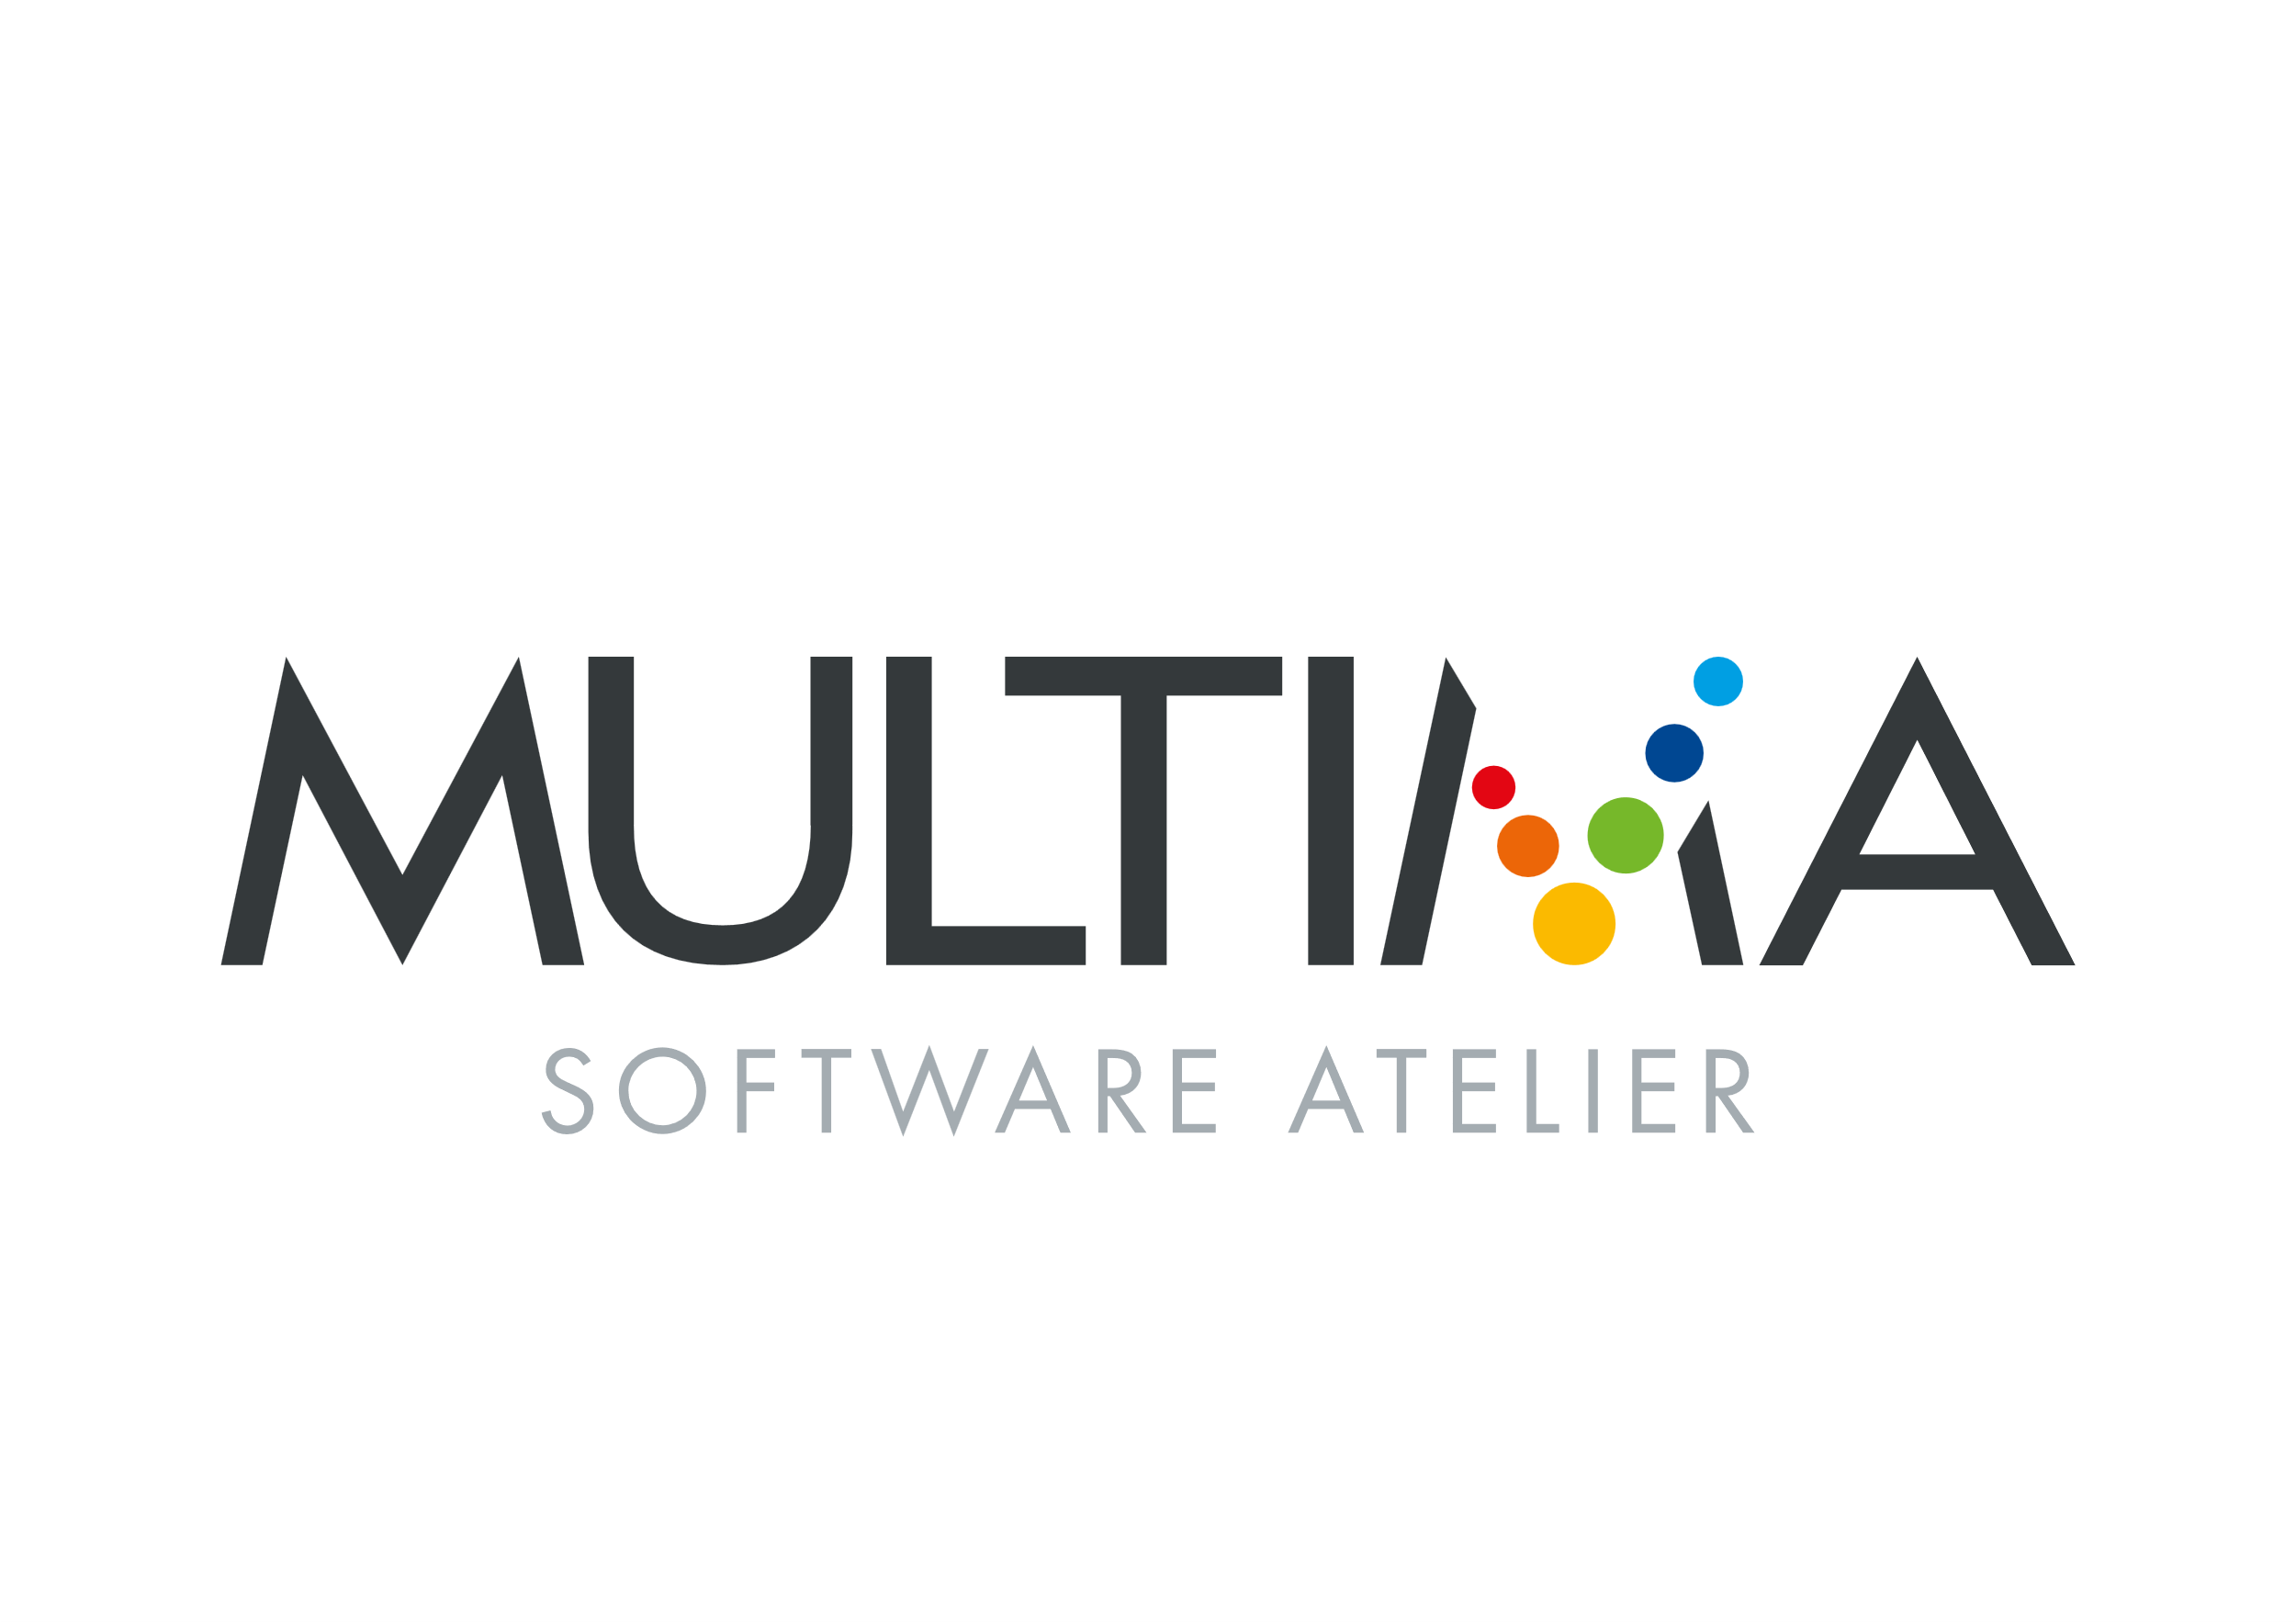






Thank you for making this possible
POWER
CONFERENCE
Partners

Slide 4
Agenda
Storytime Functionality What are Virtual Tables? Different Native Data sources Leveraging the Power Platform Reporting Known Limitations Recap

Slide 5
Storytime

Slide 6
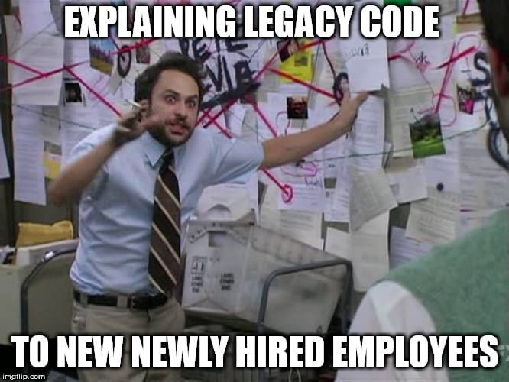

Replacing a legacy app – The data
The application we wanted to replace, had a DBF data backend
250+ tables, no known schema or relationships, no documentation

Slide 7
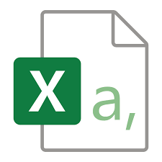
Replacing a legacy app – The export
Only software to read the data I could get, was the DBF View with export to csv option
Manually exported, hand picked over 50 tables to CSV (it was either that or learn Python)

Slide 8
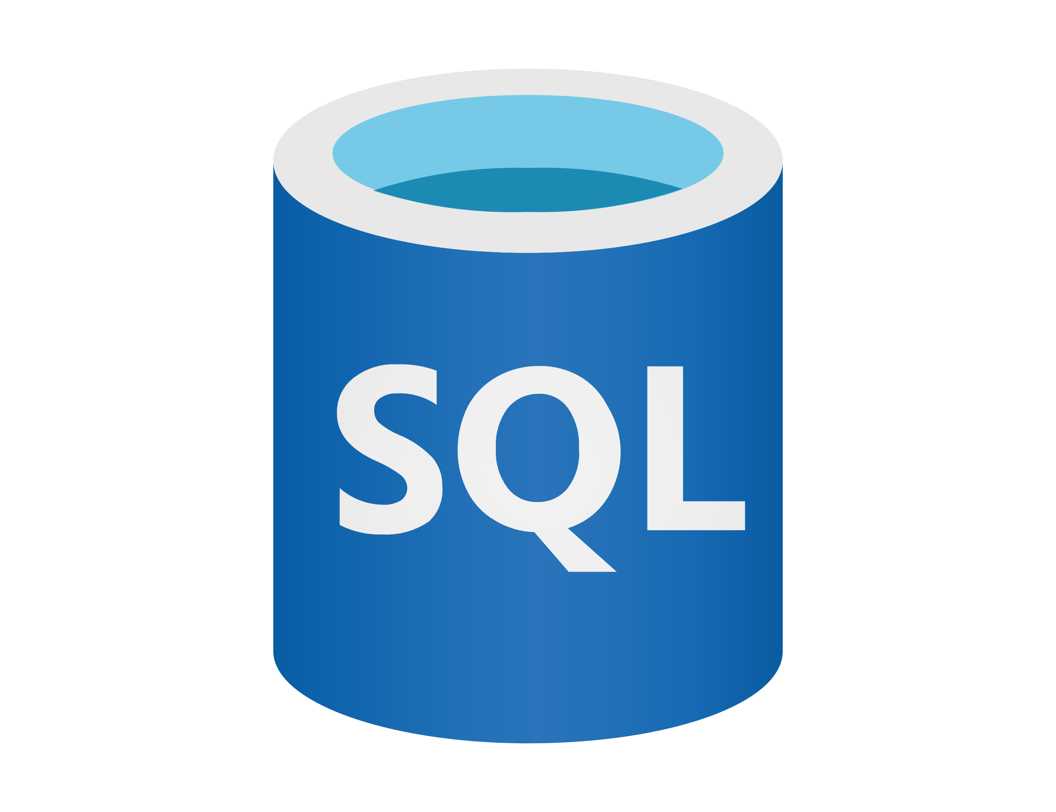

Replacing a legacy app – The solution
+
=
SQL Database
Pipeline loaded in all the data into tables
PowerApps
Connected with Virtual Tables
Dataverse
Connected to SQL using Virtual Tables

Slide 9
Replacing a legacy app – The result?
A model driven app, connected to Dataverse,
using the data from SQL.

Slide 10
Replacing a legacy app – The result?
Sounds good right?

Slide 11
What are Virtual tables?
And why should I use them?

Slide 12
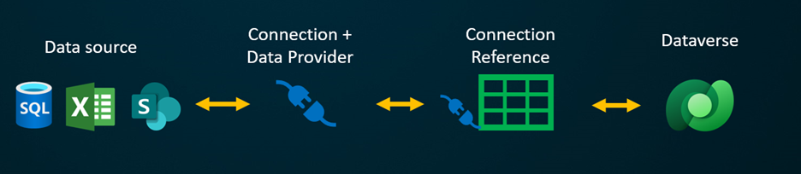
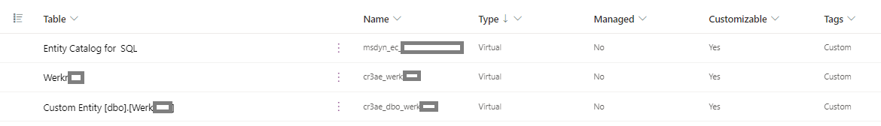
What are they?
Your Virtual Table reads your data from your data source and is able to display it in Dataverse.
Virtual connectors and tables in Dataverse
Re-use data, without needing to migrate
Use them through Dataverse in your app, Power Pages or others.
Through this connection you can automate without excessive costs for migrations.
Full CRUD (Create, Read, Update, Delete) to your data source.

Slide 13
Considerations
Architecture
Model driven apps and Power Pages can only use Dataverse as a data source.
Auditing
Auditing can only take place on the source, not on the Virtual Table itself, does this fit the requirements?
Data Migration
Does the client have budget and desire to move the data?
Functionality
Does the solution fit within the constraints of Virtual Tables?
Is your source SQL and do you want dropdown menus?
You can reuse data.
Prevent high costs.
Premium license needed.
Can we add new components to the apps that are compatible?

Slide 14
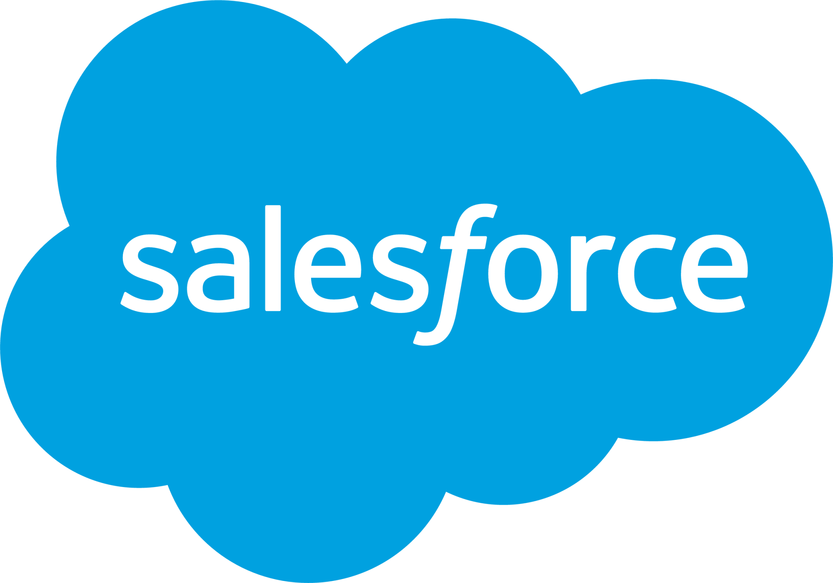



Timeline
2004
NAVision –Virtual tables – links to tables on SQL
Oct ’21
May ‘22
Virtual Connector Provider – register with Azure – No code required
Mid-2022
Full CRUD
2023 - March
Dataverse for Teams support
2024
Polymorphic relationships added
Supports relationships
Pre-2021
1998
1997
4d web component
1996
ZappySys Driver First Virtual Tables?
Microsoft Jet 3.5
No Virtual Data connector Provider – Requires Code
Jan 2023
Virtual Connector Provider- NEW wizard
No Code
Customize names
Quick setup
Notes:
Finance and ops, used to be virtual entitys, uses an entity model, points to multiple tables
Filtering Dynamics 365 Finance and Operations Dataverse Virtual Entities in Customer Portal | Dynamics Chronicles (dynamics-chronicles.com)
It’s different in the technical side on the schema side of things
Virtual table is single table to single table

Slide 15
Functionality

Slide 16
Virtual Table Providers
 | Virtual Connector Providers | OData Data Providers | Custom Data Providers
Code required | No Code | Pro | Pro
Data sources supported | Excel, SharePoint, SQL (new: Fabric, Snowflake, Salesforce, Oracle) | OData web services; such as D365 or Azure | Custom plugins to call APIs
Easy to setup/ Supportability | Easy | Medium | Difficult
Notes:
Odata V4 supports crud

Slide 17
What can it do?
Connect to your data source that’s not natively on Dataverse
Full CRUD operations for custom virtual tables (if the source let’s you)
Multi-Table (Polymorphic) lookups supporting virtual tables
Meaning, you can create lookup tables from and to your virtual table.

Slide 18
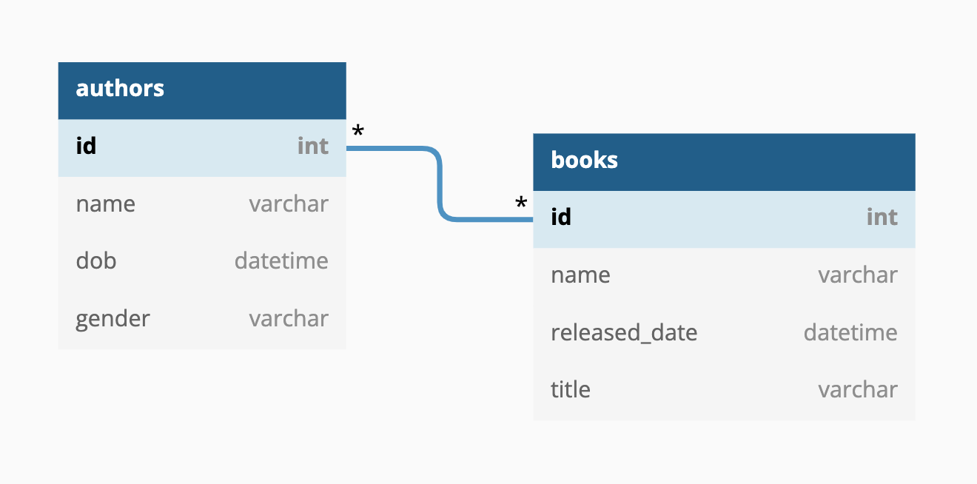
Relationships in Virtual Tables

Slide 19
Relationships
Virtual tables are enabled for relationships. You can set up 1:N, N:1, and custom multi-table (polymorphic) relationships. Relationships can be established between:
Local tables in Dataverse and virtual tables.
Virtual tables and other virtual tables from the same provider, for example SQL->SQL.
For instance, you can't set up a relationship between a virtual table created using the OData virtual table provider and a virtual table created using the virtual connector provider.
More on Virtual Table relationships here

Slide 20
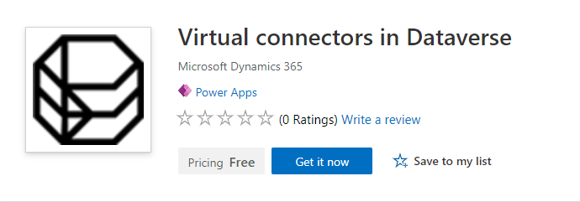
Installing Virtual Connectors in Dataverse
Make sure you have Premium
(without it, you won't be able to use Dataverse or virtual tables)
Go to AppSource
Search for Virtual Connectors in Dataverse
Install in your desired environment
You’re now ready to use virtual tables.
Notes:
For some that have noticed it, it still has the old common data service logo

Slide 21
Create a virtual table

Slide 22
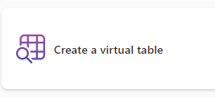
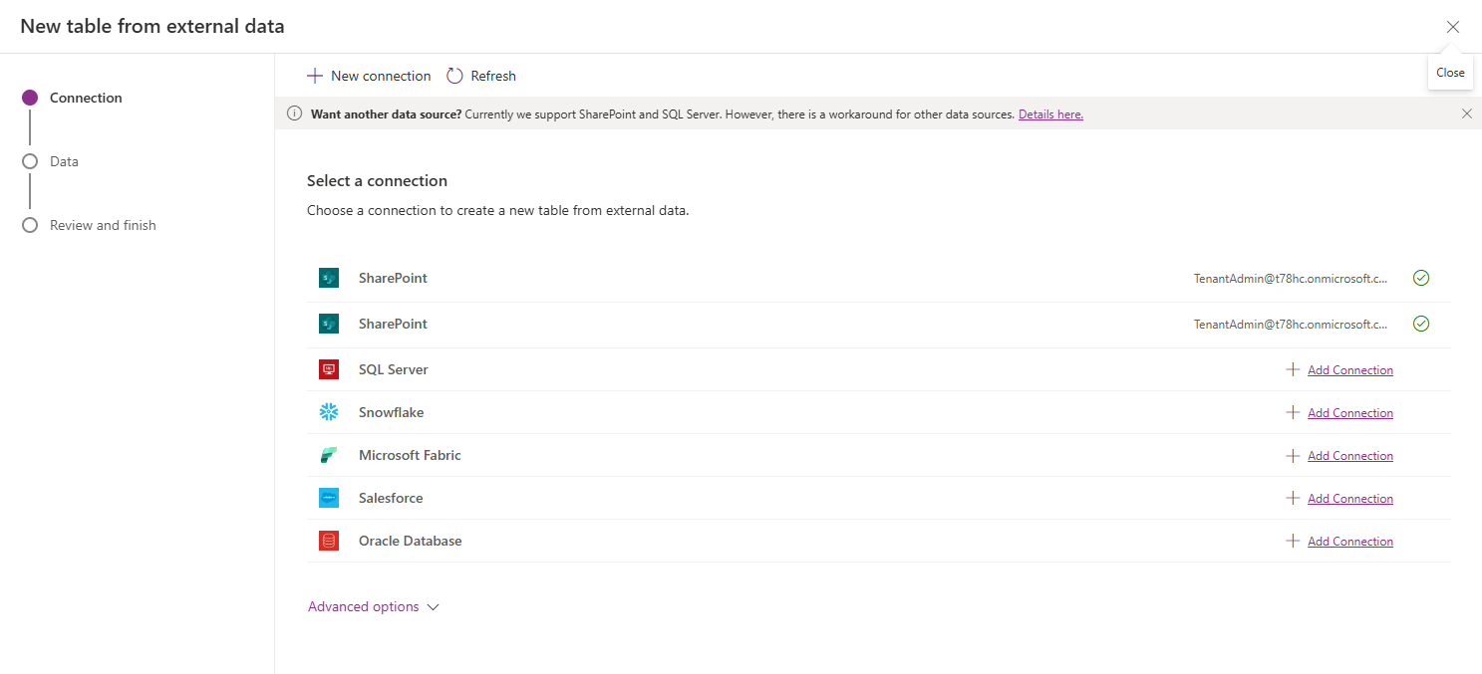
Create a virtual table

Slide 23
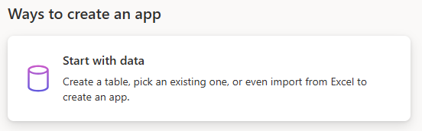
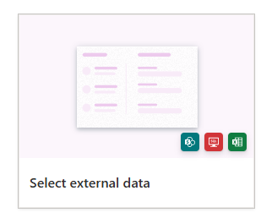
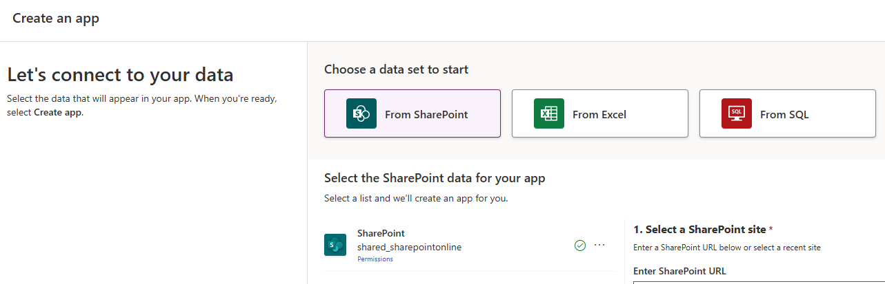
Create a virtual table through creating an app

Slide 24
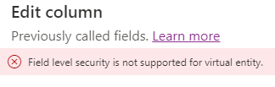


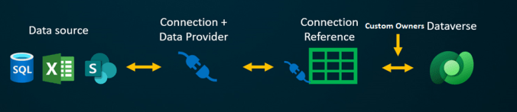
Governance and Column level security
Virtual tables are organizational level tables.
It will display whatever your account authorized to it has access to.
Security at the source, and through security roles on Dataverse.
No Field Level, or Column level security is possible/supported currently.
Custom lookup fields with polymorphic lookups
It is possible to create custom security through polymorphic lookups and plugins.
Check out this article by Dynamics Ninja that explains how:
Virtual Tables - Custom Ownership - Dynamics Ninja
Quick tip for the Security role in Dataverse; Make sure to add rights to the Connection table.
Notes:
There are gaps in the way the api is treated, for example:
SystemUpdate() can be used on an item, and this does NOT change the modified date.
No way to moderate editing system generated data

Slide 25
Different Native Data sources

Slide 26

Let's start with the elephant in the room - Excel
Notes:
Interact, has anyone ever used Excel or interacted with it?

Slide 27
Why is it such a bad idea?
Data needs to be in tables
Macros not supported
Formulas not supported
Excel is currently not supported in the table driven Virtual Table experience
Excel files must be stored on a OneDrive to participate in a Virtual Table connection
The workbook cannot be in use when using it for Power Apps or Power Automate
Specific Excel Connector Limitations: Excel Online (Business) connector reference.
Notes:
Easier for clients because they already have most data in excel
Legacy apps can often work with excel
Full list of cons in the full slidedesk which will be shared later

Slide 28
Different Native Data sources

Slide 29
Limitations
You currently can't select an All view for SharePoint columns on a virtual table. This is a known issue. (It is known)
The following column types can't be included in a virtual table at this time:
Person
Image
Managed metadata
Location: coordinates
Attachment
SharePoint specific columns that will be shown in the virtual table:
Compliance Asset ID is an internal column from SharePoint for tracking purposes. It can be ignored.
ID is the external primary key from SharePoint. It's read-only and can be ignored.
Choice fields supported for SharePoint!
Attachments can be uploaded to the virtual table connection
Notes:
For sharepoint it uses a non-existend string, to get the value across for choice columns
It uses an Index that gets added to the string, to match to the sharepoint column

Slide 30
Different Native Data sources

Slide 31
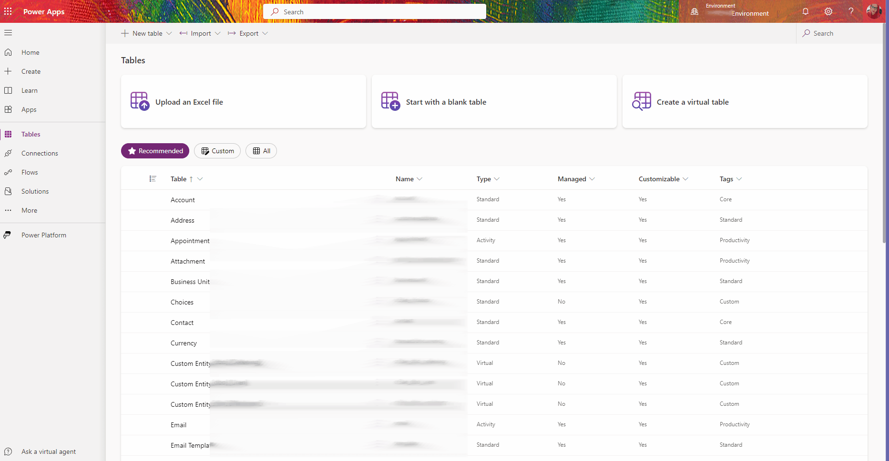
Connecting to SQL
Pro tip! toggle/checkbox/Boolean
Convert your SQL column to BIT
BIT is an integer with 0 and 1
Dataverse Choices to SQL backend- Update! - Power Platform Tips & Tricks (nathalieleenders.com)
Notes:
Both the classic and connect to external table/new virtual table method.
SQL knowledge is recommended if you need to customize the data backend.
Connect to any SQL table you have access to using your AD credentials or a service account.
Virtual table works with enum values, but in SQL it’s its own item
That’s why choice columns to SQL don’t work
You can create a plugin that parses the value of the dropdown or choice column to the SQL backend
Future idea, create Plugin that actually updates the SQL backend

Slide 32
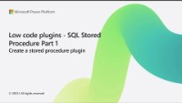
Virtual stored procedure
Through the Dataverse Accelerator App
Dataverse uses the plugin capability to call stored procedures.
You can specify how you want to fill it through the wizard.
Input what is needed, in the plugin it will allow you to say:
field a is input 1
field b is input 2
Make it execute on a button as an onclick event
Run and push it the output only to a SQL table
Access a Virtual Table to access the SQL Table
No delegation issues That is an issue through when you try through Power Automate. Also, it’s much faster and much more responsive.
Output stays in SQL right now but this could be valuable to your client process.
Notes:
https://www.youtube.com/watch?v=n9u5PAgOzjg
Plugin capability – build in Dataverse, call the stored procedure, specify how you want to fill it
Input that are needed, in the plugin it will allow you to say, field a is input 1, field b is input 2.
Make it execute on a button, onclick event, run push it to sql and to the table
No delegeation that is an issue through automate, much faster and much more responsive
Output stays in SQL right now, but could be really valuable
(8) What is Power Apps Dataverse Accelerator App ? - YouTube

Slide 33

Different Native Data sources

Slide 34

Different Native Data sources

Slide 35
Connecting to Oracle (Preview)
For Oracle connections, you must provide a server, authentication type, username, password, and a gateway.
Server should be provided in Server:Port/SID-format. Notice that the server name or IP-address needs to be accessible from the on-premises data gateway.
Notes:
Both the classic and connect to external table/new virtual table method.
SQL knowledge is recommended if you need to customize the data backend.
Connect to any SQL table you have access to using your AD credentials or a service account.
Virtual table works with enum values, but in SQL it’s its own item
That’s why choice columns to SQL don’t work
You can create a plugin that parses the value of the dropdown or choice column to the SQL backend
Future idea, create Plugin that actually updates the SQL backend

Slide 36

Different Native Data sources

Slide 37
Connecting to Salesforce (Preview)
Select Add connection:
Login URI: Select either Production (default) or Sandbox.
Salesforce API version: Select v41.0 (default) or a later version.
Notes:
Both the classic and connect to external table/new virtual table method.
SQL knowledge is recommended if you need to customize the data backend.
Connect to any SQL table you have access to using your AD credentials or a service account.
Virtual table works with enum values, but in SQL it’s its own item
That’s why choice columns to SQL don’t work
You can create a plugin that parses the value of the dropdown or choice column to the SQL backend
Future idea, create Plugin that actually updates the SQL backend

Slide 38

Different Native Data sources

Slide 39
Connecting to Fabric (preview)
Preview features aren’t meant for production use and may have restricted functionality.
While the table you selected from Fabric Lakehouse might not have a primary key defined, you need to select a field that is unique to continue.
If you don't select a unique field, the table might not show all the records. While the wizard selects a field based on metadata available, the selection might not be accurate.
Notes:
Both the classic and connect to external table/new virtual table method.
SQL knowledge is recommended if you need to customize the data backend.
Connect to any SQL table you have access to using your AD credentials or a service account.
Virtual table works with enum values, but in SQL it’s its own item
That’s why choice columns to SQL don’t work
You can create a plugin that parses the value of the dropdown or choice column to the SQL backend
Future idea, create Plugin that actually updates the SQL backend

Slide 40
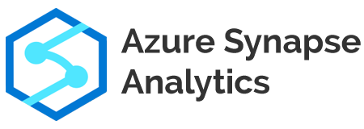
Different Data sources
Azure Data lake to serverless SQL

Slide 41
Connecting to Azure Synapse and SQL
Get a data lake
1
Create a Serverless SQL Pool
2
Connect to External Tables, to the Parquet files
3
Connect to Virtual Tables
4

Slide 42


Virtual tables with AAD table?
AAD User (Azure Active Directory/Entra ID) is different from the User table in Dataverse.
No manager lookups, possible future feature
No groups, only users can be looked up
Dataverse User table Only displays users with a Dataverse license. AAD User table Will show anyone in the AAD User address book.
Virtual table that connects to ALL users as read-only.
This table is NOT available through Power Automate. (It leverages Graph)
Include the AAD User table in multi-table lookups (polymorphic lookups)
aaduser table/entity reference (Microsoft Dataverse) - Power Apps | Microsoft Learn
Notes:
Useful if you work for an organization that doesn’t give everyone Dataverse licenses.
Virtual table works with enum values, but in SQL it’s its own item
That’s why choice columns to SQL don’t work
You can create a plugin that parses the value of the dropdown or choice column to the SQL backend
Future idea, create Plugin that actually updates the SQL backend
Check, resolved articles, past headaches

Slide 43
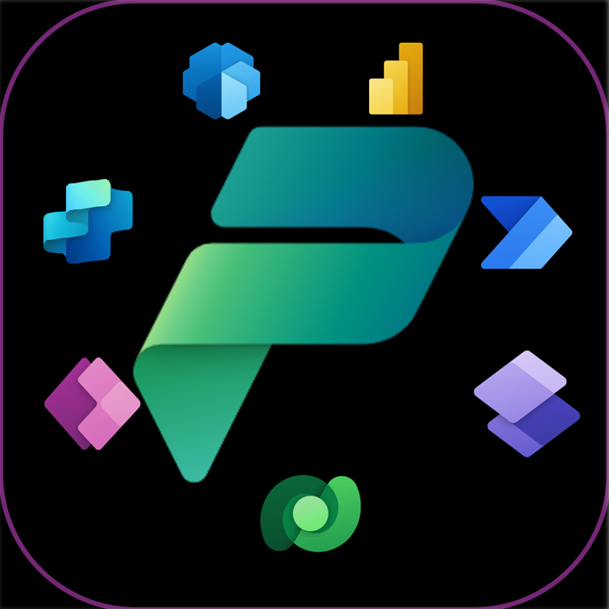
Leveraging the Power Platform

Slide 44
Model Driven Apps
‘Only’ works with Dataverse
Any other data source needs to be connected through a virtual table.

Slide 45
Canvas Apps
Works with all data connectors!
Save data locally in the table.
Patch to the virtual table with custom fields.
Display data through lookup fields

Slide 46
Power Automate
Dataverse trigger - ‘ When a row is added, modified or deleted’ doesn’t work with Virtual Tables.
Use a trigger on your data source!
For example, when a SQL item has been modified.
Dataverse trigger - ‘ When a row is added, modified or deleted’ is supported for Virtual Tables with Dataverse Events (More on that later)

Slide 47

Copilot Studio
You can call information from Dataverse, both normal and virtual tables.
Connect using Power Automate in an action to create new rows, update rows, list rows etc. for a Virtual Table.

Slide 48
Power Pages
Create a Virtual Table straight from Power Pages with SQL and Sharepoint (lists)! - connect to an external table data option.
Filter on virtual or regular on the add table interface
The icon has also changed to differentiate between the types of tables, Virtual vs Dataverse

Slide 49
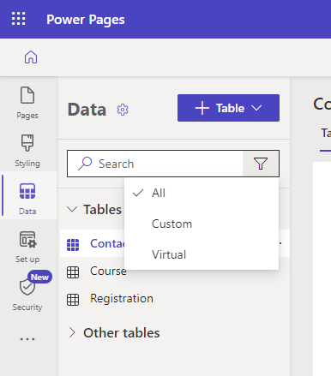
Power Pages

Slide 50

Reporting

Slide 51
Virtual Table - Reporting
Only available in PowerBI through the Common Data Service (Legacy) connector
Don’t use the Dataverse connector. It wont display the virtual tables.
You can also connect directly to the source as well.
Power Query Common Data Service (Legacy) connector
Notes:
More on API’s, custom query's later

Slide 52
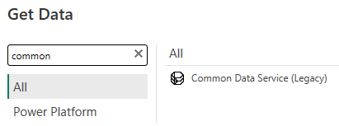
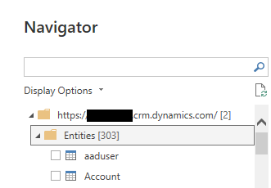
Virtual Table - Reporting

Slide 53
ALM for Virtual Tables
Make use of environment variables upon creation
provide better pipeline distribution
no more manual work afterwards! SQL and SharePoint Virtual Tables can use environment variables
Export In the solution maker you can select/create a target source
Import Users can select/provide the target source
To be added directly in the ALM Pipeline.
Notes:
Eliminates manual work, and during the export you can choose where your environment variable is located. You don’t need to re-create the connection later on Opt-In on creation/refresh Environment variables included as the data source Variable values are available in a separate table to select on export/import.

Slide 54
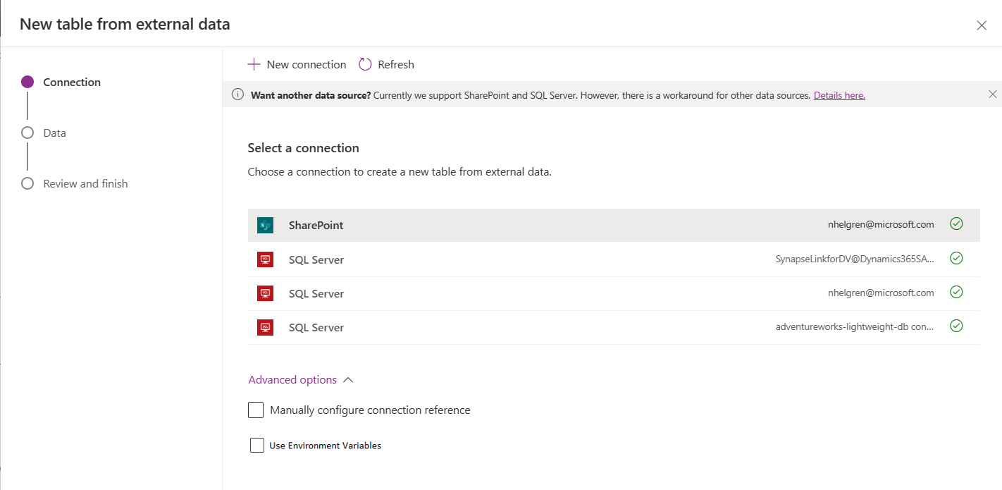
ALM for Virtual Tables
Announced in 2023 but not yet live

Slide 55
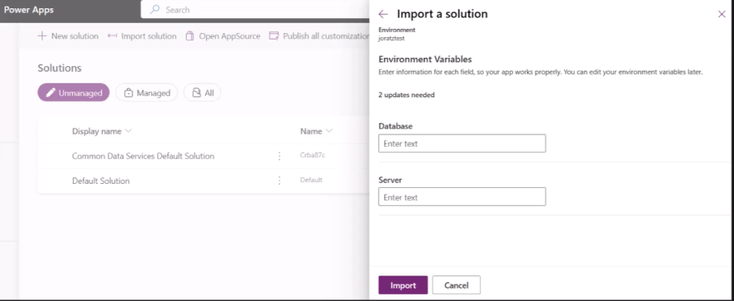
ALM for Virtual Tables

Slide 56

Known Limitations on all virtual tables + possible workarounds

Slide 57

Positive points
View data from multiple tables as a single table
Perform complex queries
View of data that is customized for a specific user or group
Access data from external sources
No need to migrate data
Cost saving – no double data storage needed like with Dataflows
Easy setup, no custom coding needed
You’re able to leverage them throughout the entire Power Platform
Supported by Dataverse for Teams

Slide 58
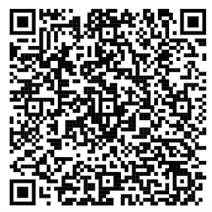
Limitations
No dropdown/choice columns on SQL data backend
No Field Level Security possible (Security at the source)
Business Process Flows are not supported
Files and attachments are not supported
Virtual table queries are limited to return 1000 records per query
Max character length for text is 4000 characters
No activity type tables (feedback)
Notes:
Nothing stored locally, cause it’s all metadata (like audit, id’s, lookups, calculations cause they’re on the server side)
Virtual connector provider instructions has specific limitations, only applies to some but not others

Slide 59

Limitations
Rollup and calculation fields not supported
Audit logs - No Dataverse auditing possible on a virtual table
Values inside Primary Column need to be GUID (non string)
The primary key needs to be correct or the data (SQL or Excel) wont display
Cannot set view on primary key column – descending
Dataverse can only create columns that include datatypes that are compatible
Existing tables cannot be converted
Virtual tables don’t allow joined connections
SharePoint will use the hidden numeric ID field present in all lists
Notes:
Nothing stored locally, cause it’s all metadata (like audit, id’s, lookups, calculations cause they’re on the server side)
Virtual connector provider instructions has specific limitations, only applies to some but not others

Slide 60

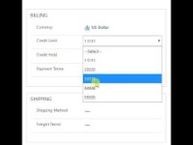
PCF components
Trick your virtual entity connection into allowing dropdowns, or other unsupported ISV/data actions.
For example: A dropdown/choice doesn’t exist into SQL. Make it look like one, but have the data be outputted as text.
What is a PCF component?
It’s a piece of code, wrapped around your control, to make it behave differently, but still have the same result
You can re-use these components throughout your solution.
After importing your component
Double click on your control in your form
Add to your form control (if desired, hide the default controls)
CSV Dropdown Control | PCF Gallery
Pro tip – Make sure you also import your PCF component in your destination environment if you do ALM

Slide 61
Recap + final notes
Works best in cases to read information
Natively Excel, SharePoint, SQL and added Salesforce, Snowflake, Oracle and Fabric
You can use them throughout the Power Platform
New Dataverse filtering with icons for regular and virtual tables
ALM variables not yet added
Reporting possible with Virtual Tables
Any other data connectors require OData queries or other deeper technical connections
Not every column is compatible depending on your data source
They can break easily, no way to update virtual tables. You need to recreate the connection
No auditing on the virtual tables
Full CRUD ‘mostly’ works
You can only query per 1000 items. Multi stacking is possible, but not recommended

Slide 62

That’s it- Questions?

Slide 63
Thank you
Nathalie Leenders

